Slide 1
Case Study 3
Group 3- Karan, Deepan, Dhaval, Bhakti, RohitPal.

Slide 2
Motivations
Goal is to analyze movie review textual data, make and support conjectures
Textual Mining
IBM’s Watson to Microsoft’s Equivio
Pharma industry mines patents to improve drug discovery
Challenging topic

Slide 3
Data Collection
Fetch_data.py file to get data
Random split
25% Test Set (500 words)
75% Training Set (1500 words)
Initially, we used CountVectorizer as the measure
But….

Slide 4
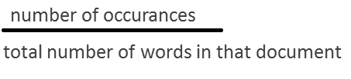
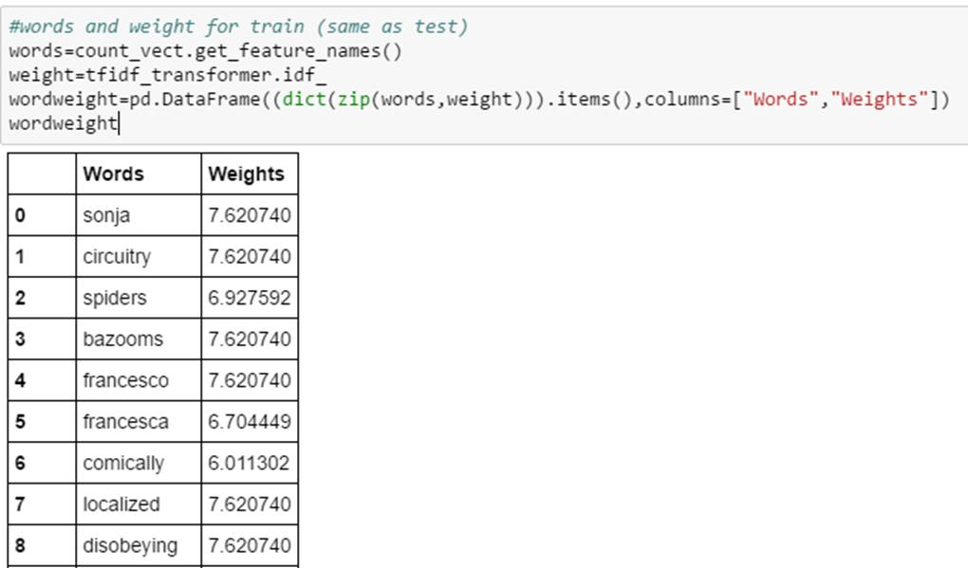
Tf-idf
Term frequency times inverse document frequency (tf-idf)
Fit our training data using tf-idf transformer function, which calculates the count matrix

Slide 5
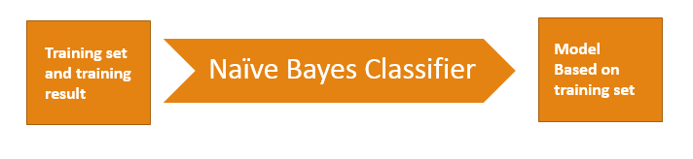
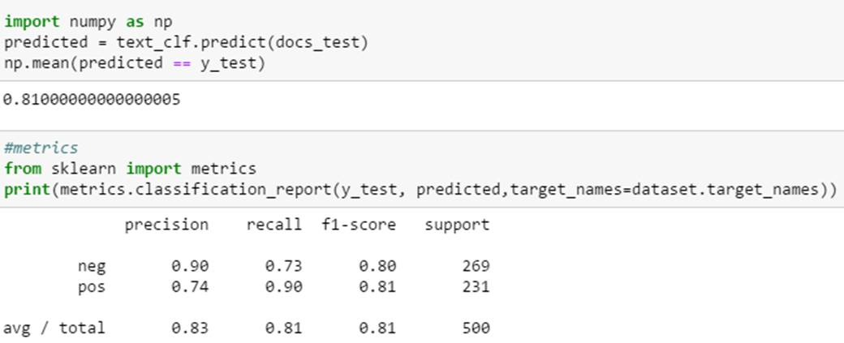
Data Classification
Naïve Bayes Classifier
81% of the data was correctly classified.
Model Based on training set

Slide 6
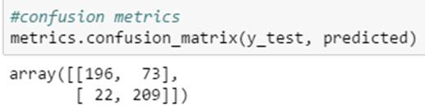
Pipeline
Pipeline in python
Creating count vectorizer, tf-idf transformer and classifier, can be combined using Pipeline function of Sci-Kit learn
Confusion Matrix:

Slide 7
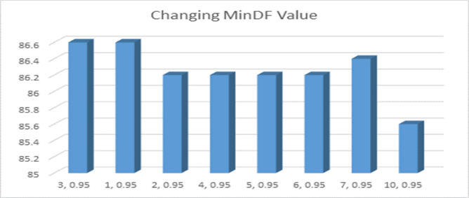
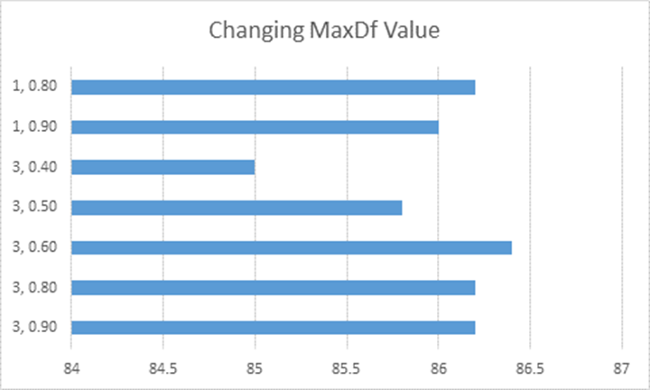
Data Analysis
tf-idf Vectorizer Class does the same work as the tf-idf and TF Vectorizer combined
Max_df , min_df

Slide 8
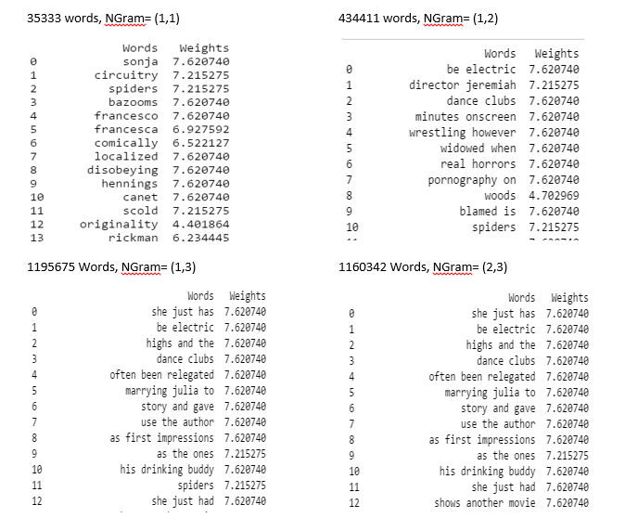
n-gram range
n-gram range
(Min value, Max Value)
Based on the analysis on n-gram
and tf-idf value, we decided our
tf-idf value to be (1, 0.95) and
n-gram value to be (1, 2), (1, 3),(2, 3)

Slide 9
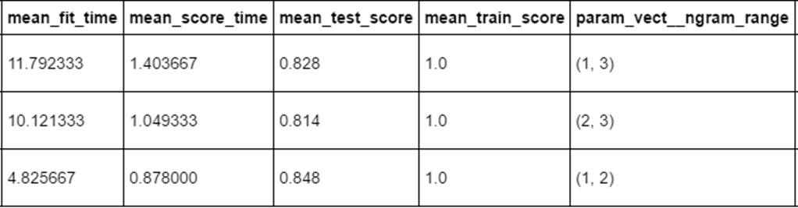
Linear SVC:
We got the best result for n gram (1, 2). 84.8% classes were correctly classified.

Slide 10
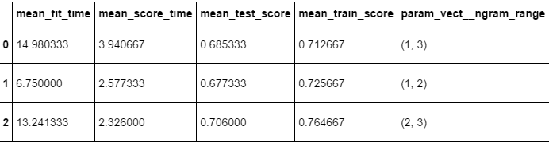
K- Neighbors
mean_test_score for NGram (2,3) is the highest compared to others

Slide 11
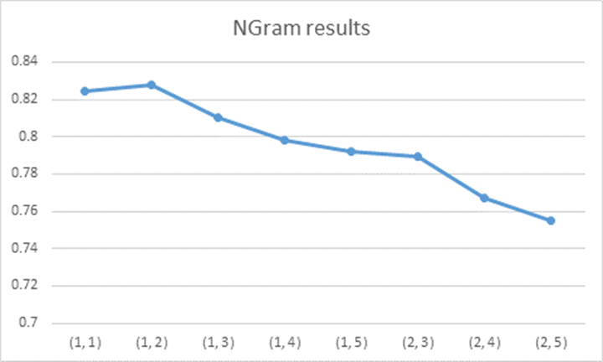
Liner SVC
These are the results for different value of NGram. We get the best value for (1,2) as shown in the figure

Slide 12
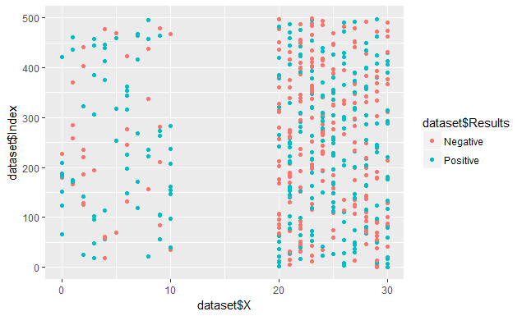
2 dimensional plot
Data Scientist Approach, Positive and Negative, Uncommon Words

Slide 13
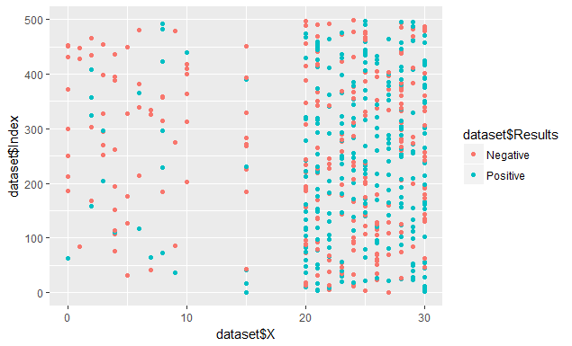
2 dimensional plots
Entire positive and negative data set
Word frequency in that particular review

Slide 14
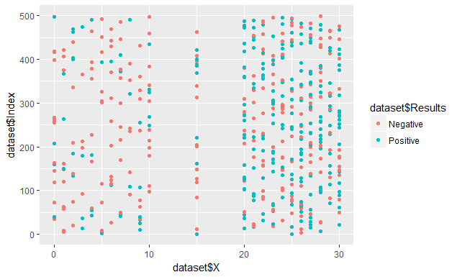
2 dimensional plots
Tried using tf-idf and tried to find out weights of each word

Slide 15


